Slide 1


Cho Hyunwoo 01/29/2024

Slide 2

Outline
Executive Summary
Introduction
Methodology
Results
Conclusion
Appendix

Slide 3
Executive Summary
By collecting data from the “SpaceX” API and Wiki, visualizing with charts, maps, dashboards and exploring the correlations with the Stage 1 success-fullness, several models were created and tested to estimate Falcon 9 Stage 1 success.
4 machine learning models where train and tested. SVM showed a fair accuracy of 79.6/100 on training stage and 15/16 on the testing stage. Nevertheless, more data is needed to increase the prediction score.

Slide 4
Introduction
“SpaceX” has privately funded the development of orbital launch systems that can be reused many times, similar to the re-usability of aircraft
Project benefits:
make spacial travel more accessible and reliable
cut costs of the project drastically
The problem is to identify whether the rocket succeed on the Stage 1

Slide 5

Section 1

Slide 6
Methodology
Executive Summary
Data collection methodology:
official “SpaceX” API
Perform data wrangling
features encoding
missing values handling
Perform exploratory data analysis (EDA) using visualization and SQL
Perform interactive visual analytics using Folium and Plotly Dash
Perform predictive analysis using classification models
How to build, tune, evaluate classification models

Slide 7
Data Collection
All the data was collected from SpaceX API by requesting them through REST API.
You need to present your data collection process use key phrases and flowcharts

Slide 8
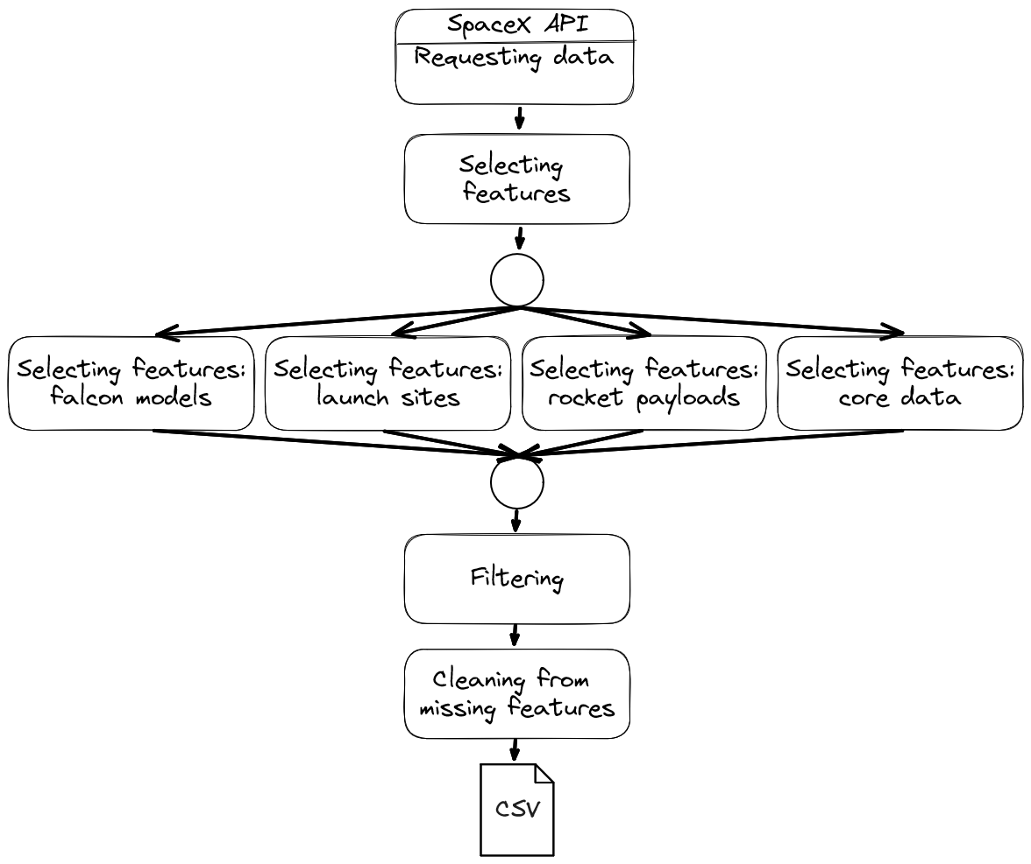
Data Collection – SpaceX API
Requesting data
Selecting features
Falcon models
Launch sites
Rocket payloads
Core data
Filtering
Cleaning from missing features
Resulting CSV

Slide 9
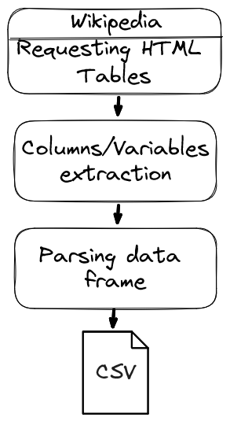
Data Collection - Scraping
Wiki request
Columns/variables extraction
Parsing data frame
Resulting CSV

Slide 10
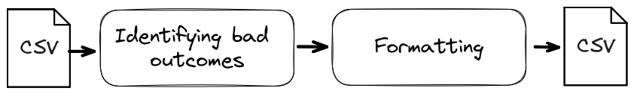
Data Wrangling
The only data wrangling applied is grouping several types of outcomes into 2 essential: success or fail.
CSV data set from the data collection pipeline
Identifing bad outcomes
Formatting
Resulting CSV

Slide 11
EDA with Data Visualization
The following visualization charts were used:
Scatter plot (to identify correlating features against success rate)
Bar chart (to distinguish success rate contributors)
Line chart (to visualize the average success rate trend line)

Slide 12
EDA with SQL
SQL queries:
Selecting 5 launch sites the name of which start with CCA
Selecting total payload mass in kilograms for NASA (CRS)
Selecting average payload mass for Falcon 9 v1.1 rocket
Selecting the first successful landing outcome for “SpaceX”
Selecting the total amount of outcomes for each type of outcome
Selecting Falcon 9 models with the highest payload mass

Slide 13
Build an Interactive Map with Folium
All launch sites:
Markers: unique launch sites (to see the locations of them)
Circles: launch sites areas (to see the approximate impact of launches)
Distance between launch sites and coastlines:
Marker: VAFB SLC-4E launch site (to highlight the launch site)
PolyLine: distance between the marker and the closest coastline (to highlight the distance)

Slide 14
Build a Dashboard with Plotly Dash
Dashboard charts (dashboard code):
Pie chart: displays the proportion of launches for each launch site for all launch sites and the proportion of success launches for a single launch site
Scatter plot: displays the correlation between payload mass and success rate for each Falcon 9 model
Filters:
Launch sites drop-down: specifies a single launch site or all of them
Payload mass range slider: specifies the payload mass range for scatter plot

Slide 15
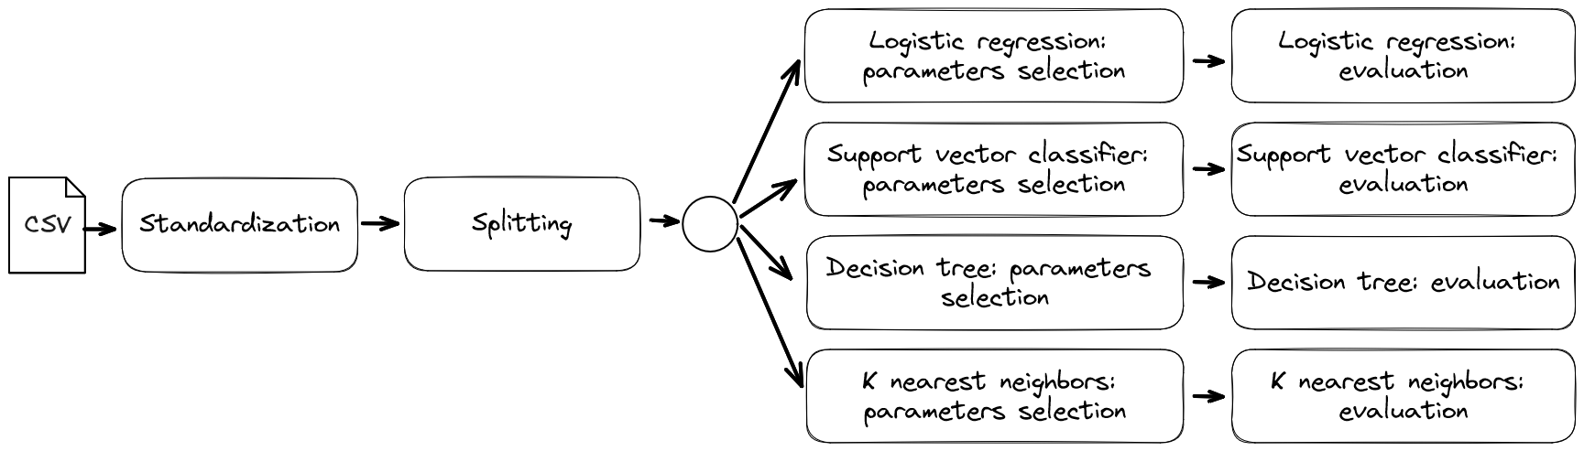
Predictive Analysis (Classification)
Models training and evaluation:
Loading CSV
Standardizing data
Splitting for training and testing
Logistic regression (parameters selection; evaluation)
Support vector classifier (parameters selection; evaluation)
Decision tree (parameters selection; evaluation)
K nearest neighbors (parameters selection; evaluation)

Slide 16
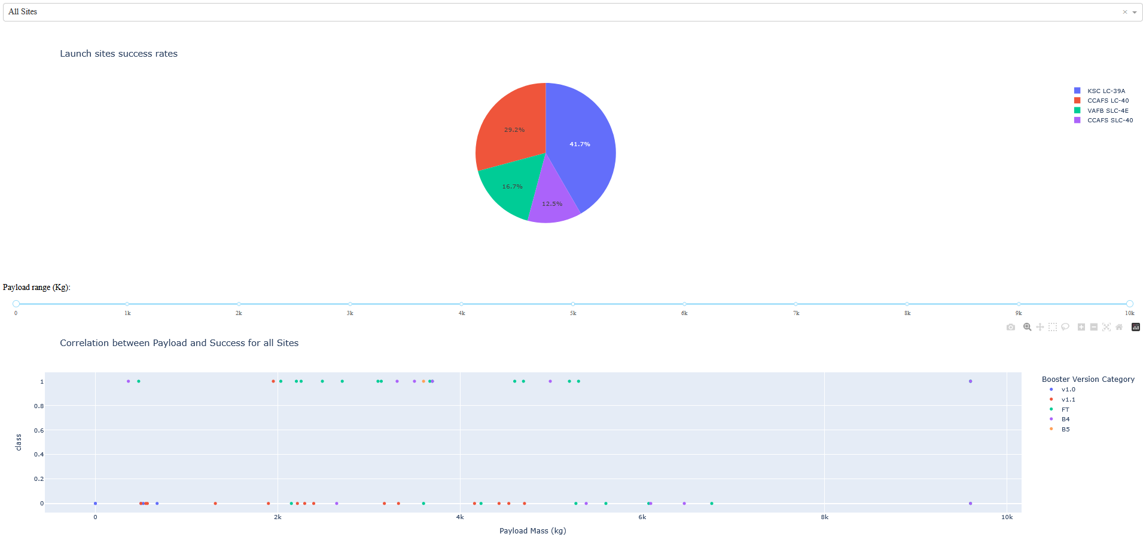
Results
Through data analysis no significant correlations has been found, except the fact that the success rate increases over time. The model with the best training and testing scores (79.6/100 and 15/16) is SVC.

Slide 17

Section 2

Slide 18
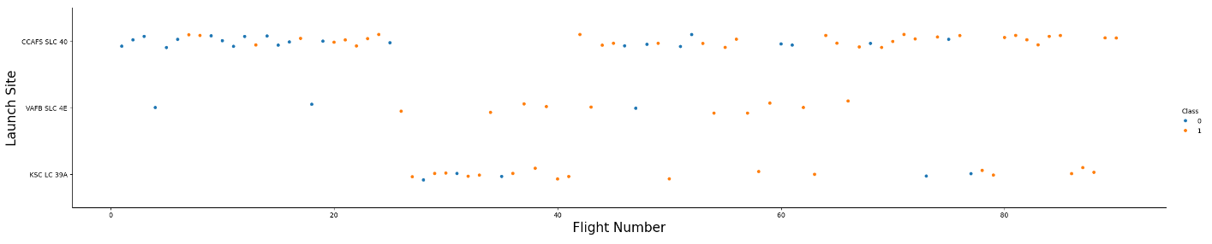
Flight Number vs. Launch Site
Note: blue dots are unsuccessful launches, while orange dots are successful ones.
The amount of successful launches increased over time, where the rapid increase happened after the 18-20th launch. It also seems that CCAFS SLC-40 was the most common launch site basing on its amount of observations compared to other launch sites.

Slide 19
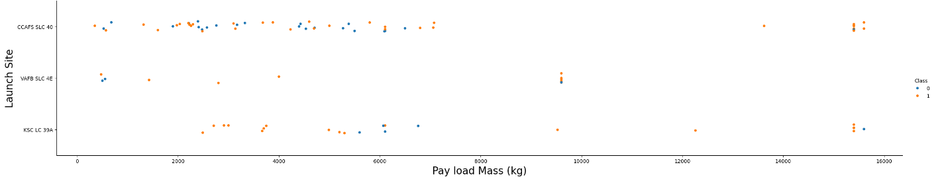
Payload vs. Launch Site
Note: blue dots are unsuccessful launches, while orange dots are successful ones.
The payload mass varies depending on a launch site. Generally, most Falcon 9 models that were launched has a payload mass in the range of 0 – 7500 kilograms. The launched rockets with the payload mass greater than 8500 kilograms have a greater success rate in comparison to the previously mentioned ranged, but less volume on the other hand.

Slide 20
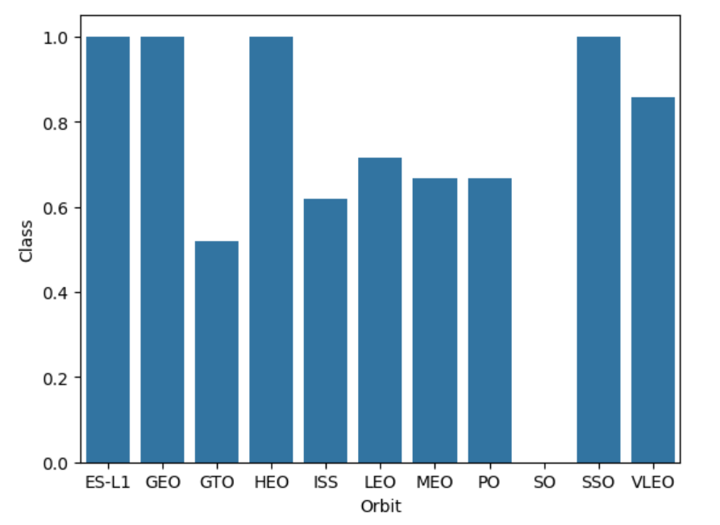
Success Rate vs. Orbit Type
The SO orbit seems has no successful Stage 1 executions. The ES-L1, GEO, HEO and SSO has the perfect Stage 1 execution. The other types of orbits, including SO, contribute to the failed exectuions.

Slide 21
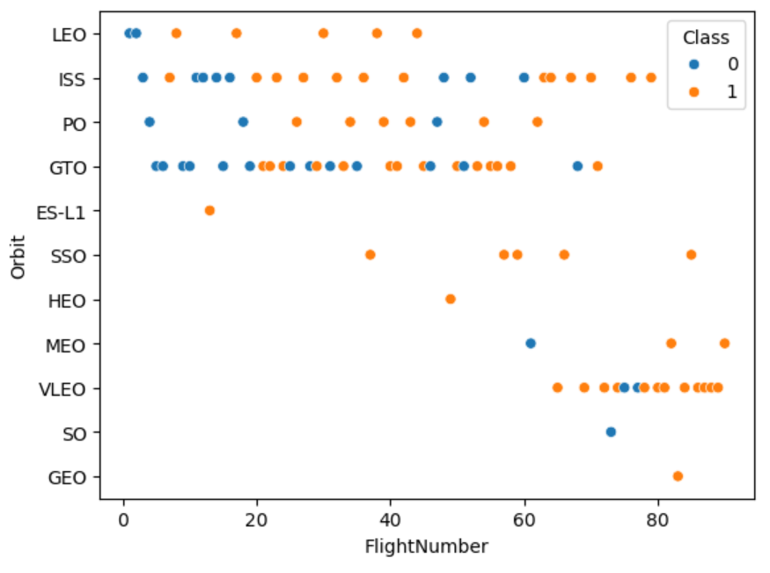
Flight Number vs. Orbit Type
Note: blue dots are unsuccessful launches, while orange dots are successful ones.
The ES-L1, SO, GEO and HEO have each a single Stage 1 execution attempts, which is not enough to judge about them. The MEO orbit should be excluded as well, considering the amount of launches. The GTO, ISS, VLEO and PO are considered to be the most common orbits used. The preference shifted from the ISS, LEO, PO and GTO torwards VLEO over the amount of flight numbers. Correlation is evident.

Slide 22
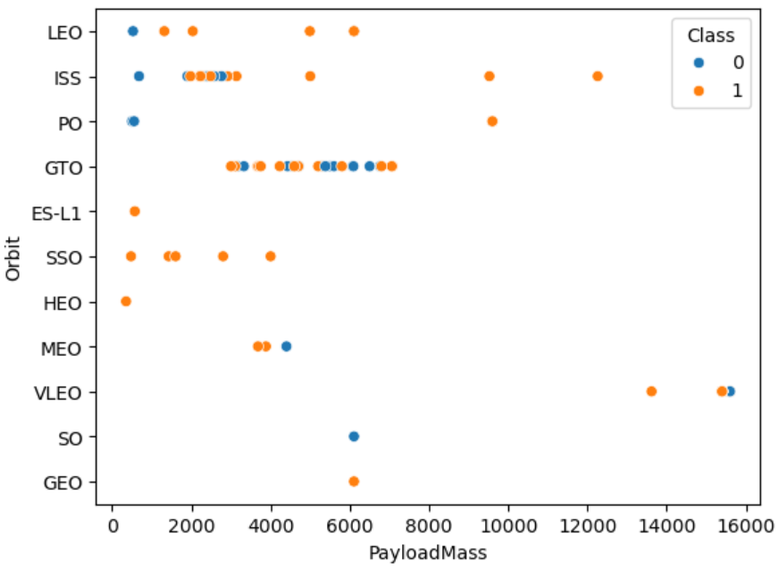
Payload vs. Orbit Type
Note: blue dots are unsuccessful launches, while orange dots are successful ones.
The Falcon 9 models targeted to VLEO had the highest payload masses. The correlation is evident.

Slide 23
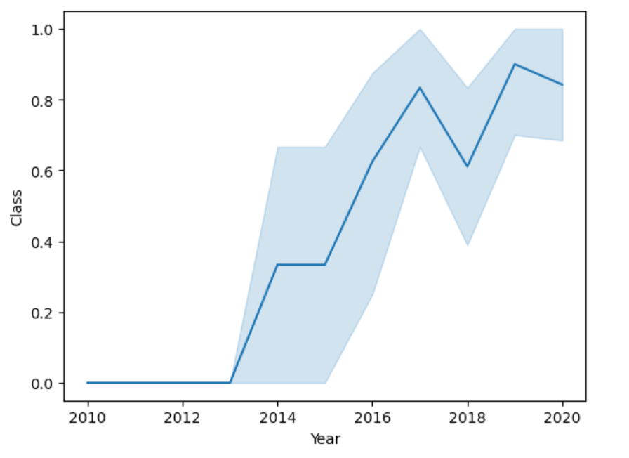
Launch Success Yearly Trend
The success rate increases over the years. It increased from 35% in 2014 to 80% in 2020.

Slide 24
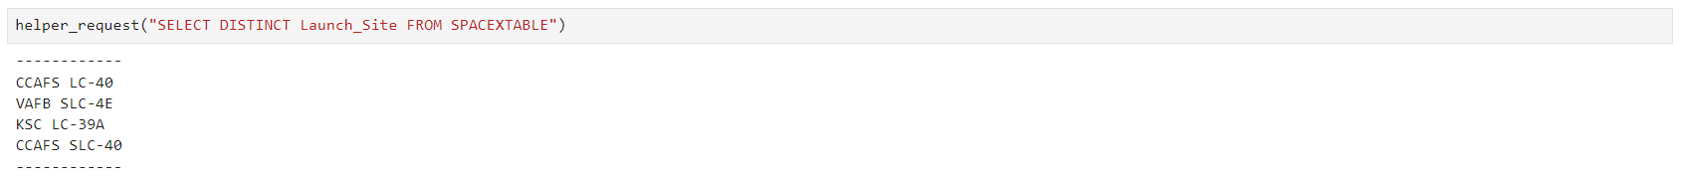
All Launch Site Names
All unique launch site titles are presented. Launch sites CCAFS LC-40 and CCAFS SLC-40 are the same launch sites, but with the different names, hence presenting 3 unique launch sites overall.

Slide 25
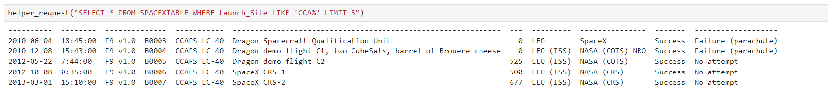
Launch Site Names Begin with 'CCA'
5 launch sites with with the names CCAFS LC-40 and CCAFS SLC-40 are presented.

Slide 26
Total Payload Mass
The total amount of payload mass in kilograms with, as the role of a customer, NASA (CRS). CRS stands for Commercial Resupply Services, whose payloads were mainly sent to ISS orbit.

Slide 27
Average Payload Mass by F9 v1.1
The average payload mass in kilograms loaded for Falcon 9 models version 1.1, which is common in comparison to other loads.

Slide 28
First Successful Ground Landing Date
The date of the first successful landing outcome is presented.

Slide 29
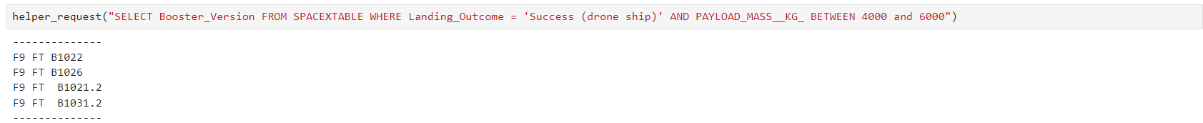
Successful Drone Ship Landing with Payload between 4000 and 6000
4 distinct Falcon 9 models with the successful drone ship and payload mass between 4000 and 6000 kilograms are presented.

Slide 30
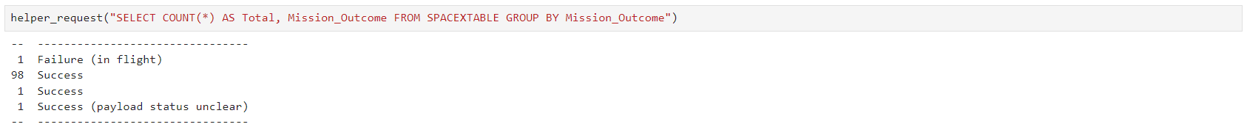
Total Number of Successful and Failure Mission Outcomes
The quantities of cases for each type of mission outcome are presented. The success rate for mission outcomes is high.

Slide 31
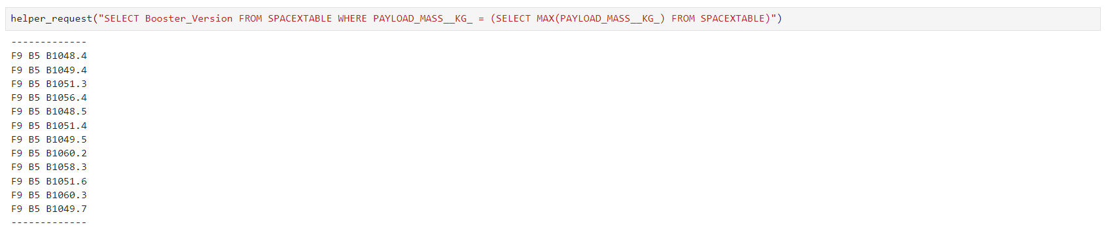
Boosters Carried Maximum Payload
12 model versions of Falcon 9 with the maximum amount of payload mass loaded are presented.

Slide 32
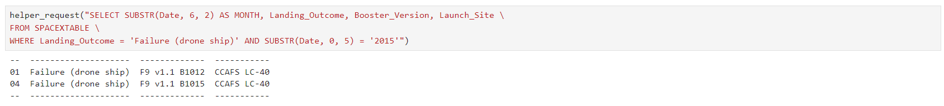
2015 Launch Records
Launch records that include the Falcon 9 models failing drone ship from 2015 are presented.

Slide 33
Rank Landing Outcomes Between 2010-06-04 and 2017-03-20
The lading outcomes consisting of cases with failure drone ship and successful ground pad between 4th June 2010 and 20th March 2017 are presented. No successful ground pad observed during this period.

Slide 34

Section 3

Slide 35
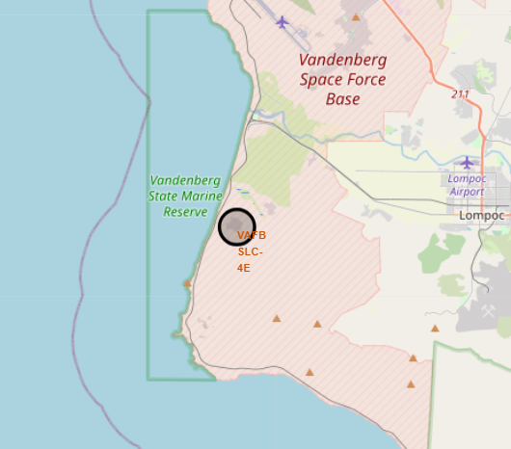
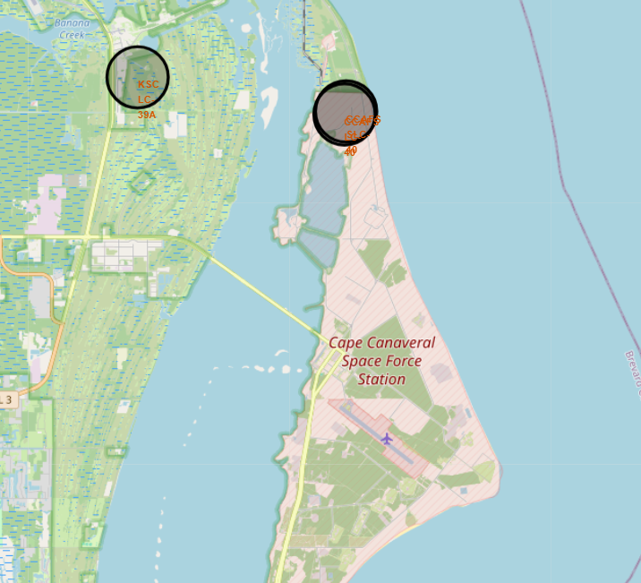
Launch Sites on a Map
All the launch sites located alongside the shores and the airports for the purpose of safety.

Slide 36
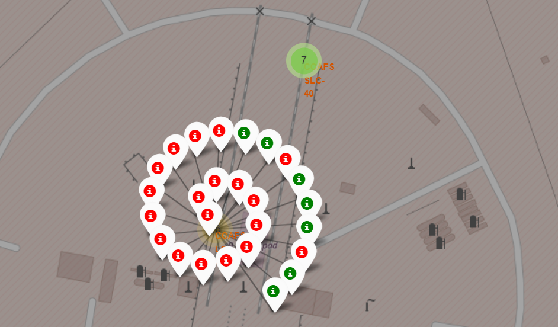
Successful and Failed Launches for Each Site
Note: red markers present the failed launches, while green ones the successful launches.

Slide 37
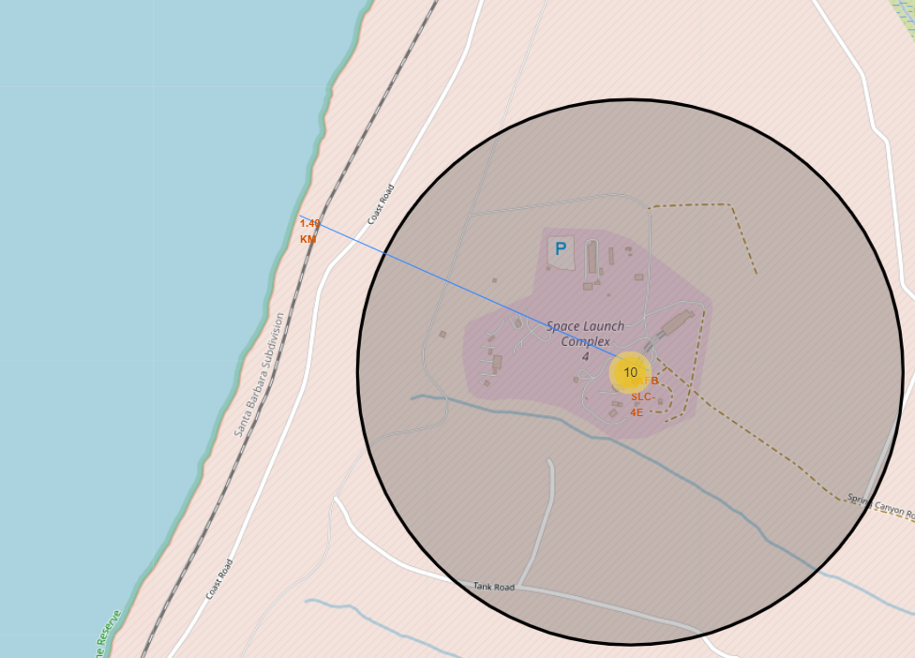
Launch Sites in contrast of Its Proximity
The VAFB SLC-4E launch site is about 1.5 kilometers away from the coastline.

Slide 38

Section 4

Slide 39
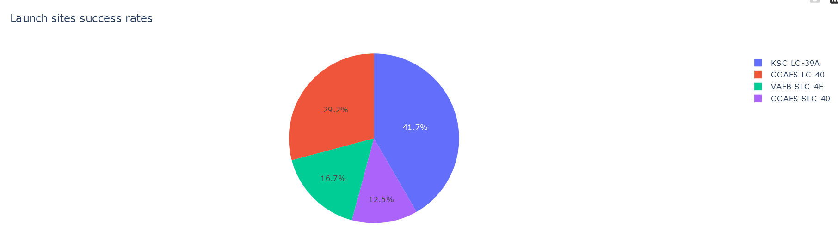
Launch Sites Success Rates
Launch sites CCAFS LC-40 with the CCAFS SLC-40 and KSC LC-39A has the same amount of successful stages 1, while VAFB SLC-4E has the least amount.

Slide 40
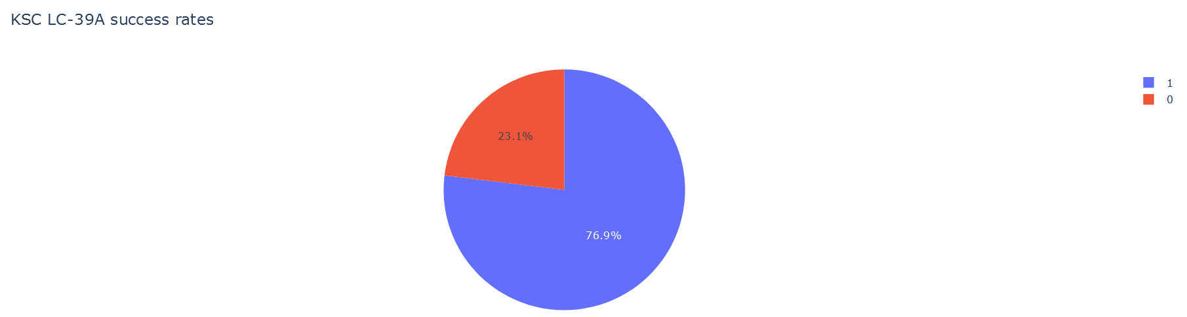
KSC LC-39A Success Rates
KSC LC-39A has the greatest success rates in contrast to other launch sites.

Slide 41
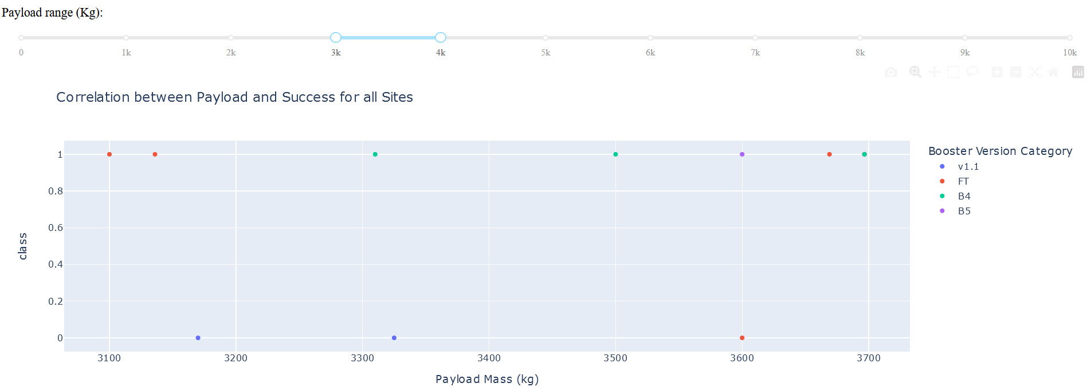
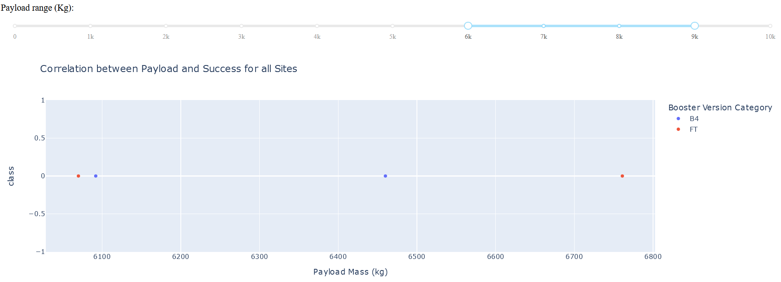
Correlation between Payload and Success for All Sites
The payload mass ranges from the 3000 to 4000 kg and from the 6000 to 9000 kg have the largest success rates.

Slide 42

Section 5

Slide 43
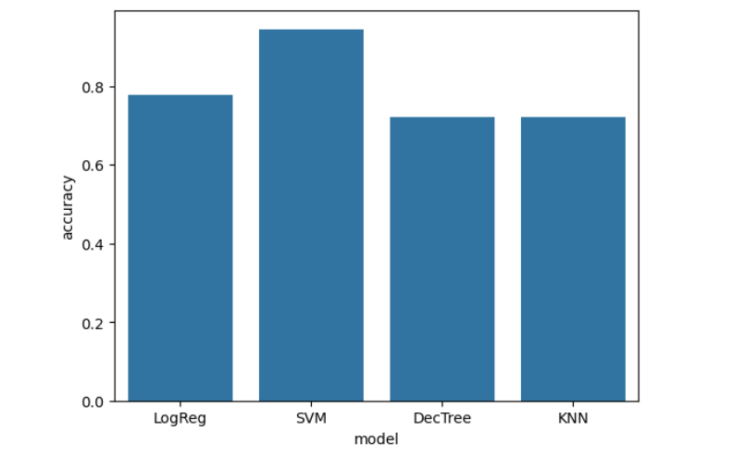
Classification Accuracy
Support vector classifier performs the best both for training and testing data sets with relative accuracies

Slide 44
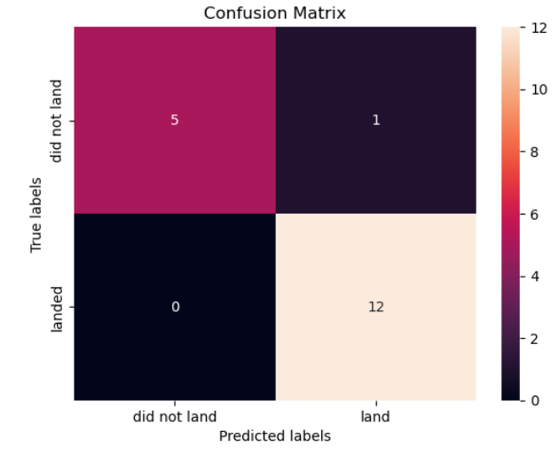
Confusion Matrix
The confusion matrix of the Support vector classifier is presented. It estimated correctly 12 successful and 5 failed cases.

Slide 45
Conclusions
The data used in the project were taken from SpaceX API and Wikipedia
Visualization and dashboards were presented
The model was created with the highest accuracy of 79.6% on training and 94.4% on testing data set
More data is needed to draw more reliable insights

Slide 46
Appendix
All the datasets used in the lab were taken from the IBM cloud: https://cf-courses-data.s3.us.cloud-object-storage.appdomain.cloud/IBM-DS0321EN-SkillsNetwork/datasets/
Repository: https://github.com/Dimonoy/IBM-Course-Projects
Notebooks: https://github.com/Dimonoy/IBM-Course-Projects/tree/master/Final-project

Slide 47


